Slide 1
Bitcoin Tweets
IST 652 Final Project
Lorenzo Gordon

Slide 2
Goal:
The goal of this analysis is to investigate tweets in 2021 that are around bitcoin and do a sentiment analysis.
Also, I hope to investigate Bitcoin prices to see if there are any trends that visible

Slide 3
What is Bitcoin
“Bitcoin is a cryptocurrency, a virtual currency designed to act as money and a form of payment outside the control of any one person, group, or entity, and thus removing the need for third-party involvement in financial transactions. It is rewarded to blockchain miners for the work done to verify transactions and can be purchased on several exchanges. Bitcoin was introduced to the public in 2009 by an anonymous developer or group of developers using the name Satoshi Nakamoto.”
- https://www.investopedia.com/terms/b/bitcoin.asp

Slide 4
Bitcoin 2021 News
Jan 19 2021- Elon Musk placed the handle #Bitcoin in his Twitter profile, tweeting "In retrospect, it was inevitable”
Feb 8th 2021- Tesla's announcement of a bitcoin purchase of US$1.5 billion and the plan to start accepting bitcoin as payment for vehicles
June 2021- the Legislative Assembly of El Salvador voted legislation to make bitcoin legal tender in El Salvador.
Oct 16th 2021- the SEC approved the ProShares Bitcoin Strategy ETF, The first bitcoin ETF in the United States

Slide 5
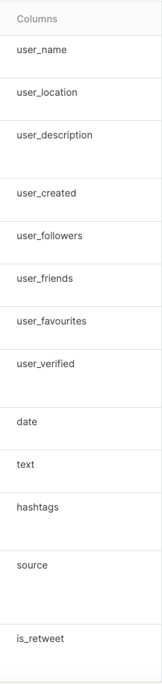
Data
List of Fields:
Kaggle Dataset:
Tweets: https://www.kaggle.com/datasets/kaushiksuresh147/bitcoin-tweets
Number of records: 4,132,335
- Initially attempted to pull tweets through snscrape, but due to the size of tweets I was looking for time it took to pull the information was too long

Slide 6
Preprocessing Steps
Read in the CSV file into a pandas dataframe
Convert date into a datetime field
Ran into an error where there were “Btc” or “ETH” located in the date columns had to remove these rows. (27 Rows)
Checked for any tweets with an NA text
Filter the data using datetime for the year 2021
Dropped columns (source, user_created, user_favourites,user_name(not @ name))
Took a sample of 5% of the records to start the sentiment analysis (about 100,000 observations

Slide 7
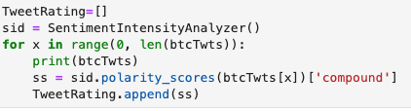
Sentiment Analysis (code)
I performed my sentiment analyst with SentimentIntensityAnalyzer from NLTK vader.
I decided on using the compound as it is the sum of the pos, negative, and neutral scores that are given by the polarity scores method and is normalized from -1 to 1
Code:

Slide 8
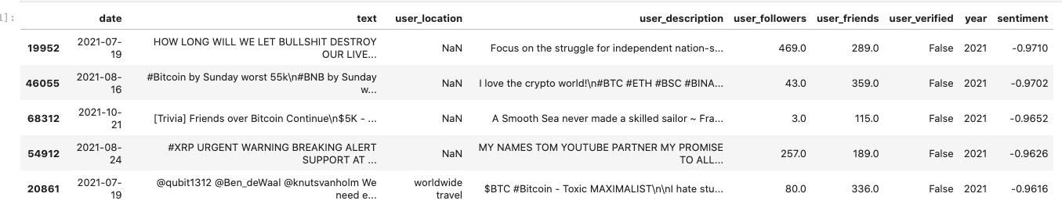
Sentiment Analysis (negative tweets)
Some of the lowest scores for the sentiment analysis were the following tweets:

Slide 9
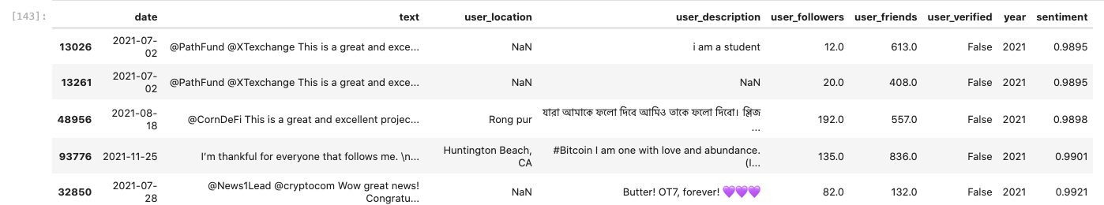
Sentiment Analysis- (positive tweets)
Some of the highest scores for the sentiment analysis were the following tweets:

Slide 10
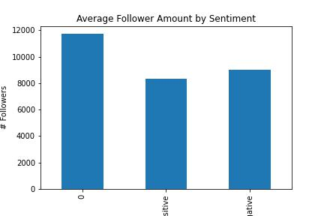
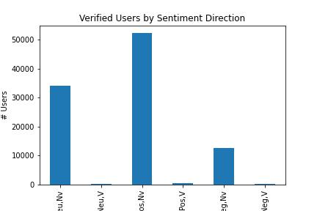
Sentiment Analysis- (Follower count | status)
Looking at the types of users that are tweeting based on their sentiment.
When looking at the follower account the users with the highest number of followers seem to have more neutral sentiments on bitcoin while positive sentiments are last in average follower amount.
In general, most of bitcoin related tweets came from unverified accounts, and the highest amount of tweet activity came from unverified users with positive sentiments

Slide 11
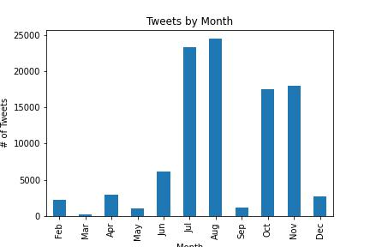
Sentiment Analysis (Tweet by month)
Looking at the overall bitcoin related tweets by month we can we that there is a big spike that happed towards the second half of the year. Also, there is a relative spike from march to April after the fall

Slide 12
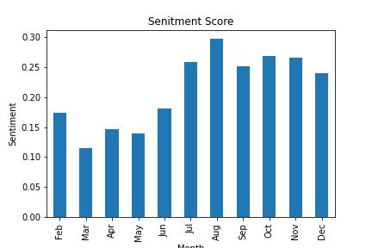
Sentiment Analysis (Sentiment by month)
The overall sentiment by month seems to be positive, with most of the higher end sentiments coming towards the back end of the year like the increase in tweet volume. We do see a drop off from feb to march and then a slight increase in April

Slide 13
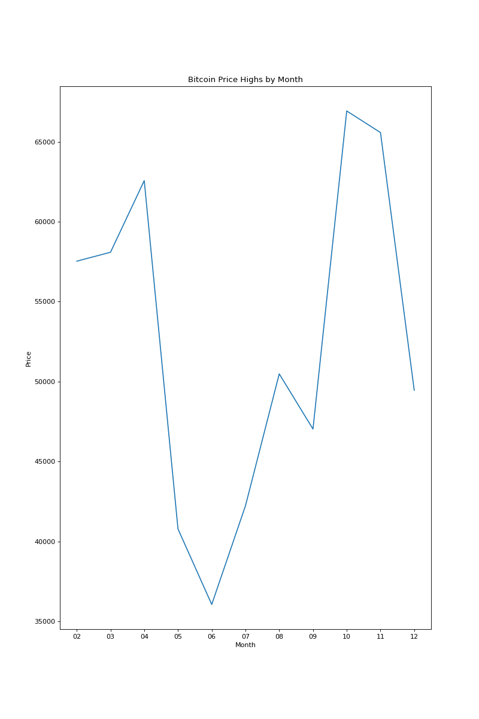
Sentiment Analysis (Bitcoin Price)
Pulled in bitcoin price data from Yahoo Finance and decide to the look at the highs for each month to see if it followed a similar trend of the sentiments
Feb to April Seem to have some of the highest total before a dip happens towards the summer. The second half of the year starts to pick up with highs in the fall.

Slide 14
Conclusion
Seems like there was a positive twitter sentiment around bitcoin throughout 2021.
Most of the positive tweets tend to come non verified accounts with a smaller following
Interested to see if these are bots or spam accounts
The most positive sentiments seem to have happened in the second half of 2021.
Bitcoin price action seems to follow that trend as it reached its year highs in the second half of the year.

Slide 15
Future
Look into some of the big news highlights from 2021 and see the sentiments around them
Investigate the positive nonverified accounts and if they are legit accounts
Hope to use a bigger sample of data to do analysis

Slide 16
Questions

